Slide 1

GraphQL Meetup Hamburg | June 2018 | @nilshartmann
NILS HARTMANN
Schema
Stitching
with Apollo GraphQL
Slides: https://bit.ly/meetup-schema-stitching

Slide 2
@nilshartmann
NILS HARTMANN
Software Developer from Hamburg
JavaScript, TypeScript, React
Java
Trainings, Workshops
nils@nilshartmann.net

Slide 3
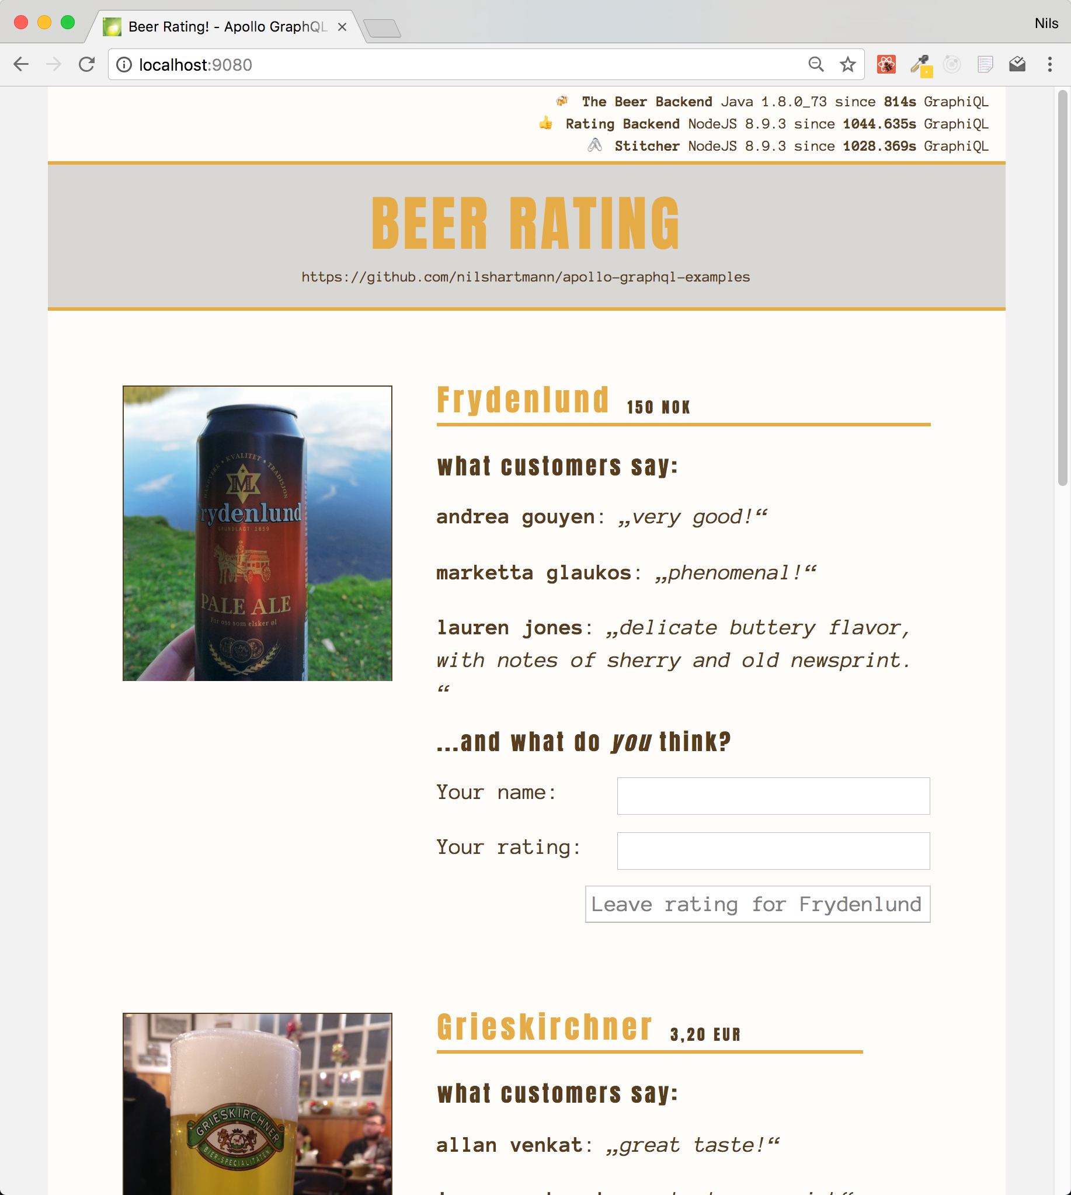
Source Code: https://bit.ly/graphql-stitching-example
Example

Slide 4
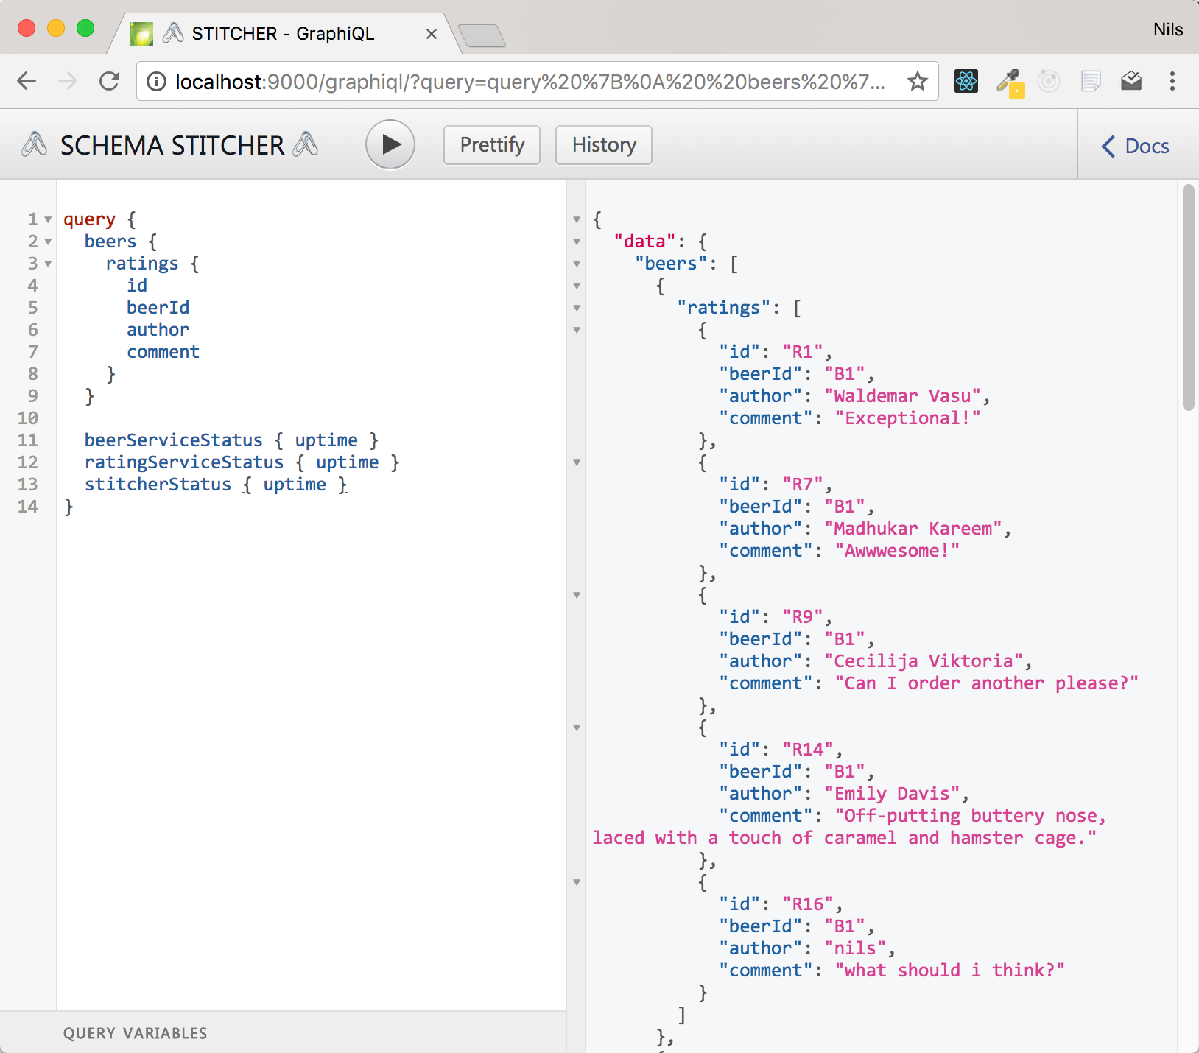
http://localhost:9000
Demo: GraphiQL

Slide 5
Architecture

Slide 6
Align Multiple APIs
Provide one API
for the Client

Slide 7
Align Multiple APIs
Rename ambigous
types and fields

Slide 8
Align Multiple APIs
Add fields to
existing types by
linking to
schemas

Slide 9
Apollo GraphQL
Apollo Server: https://www.apollographql.com/docs/apollo-server/
Open-Source-Framework for building GraphQL Server (JavaScript)
Exposes Types and Resolver (Schema) via HTTP endpoint

Slide 10
Apollo GraphQL
Example: GraphQL Server on one slide
const express = require("express");
const bodyParser = require("body-parser");
const { graphqlExpress } = require("apollo-server-express");
const { makeExecutableSchema } = require("graphql-tools");
const typeDefs = `
type Query { hello: String! }
`;
const resolvers = {
Query: { hello: () => "Hello, World" }
};
const schema = makeExecutableSchema({
typeDefs,
resolvers
});
const app = express();
app.use("/graphql", bodyParser.json(), graphqlExpress({ schema }));
app.listen(9090);

Slide 11
Tasks
Implementing a Schema Stitcher using Apollo Server...
Create a "Remote Schema" for each endpoint
Rename ProcessInfo type and ping field from each schema
Create the "link" between the two schemas
Add ratings field to Beer type
Merge schemas into one new Schema
Expose merged Schema via HTTP Endpoint

Slide 12
Tasks
Implementing a Schema Stitcher using Apollo Server...
Create a "Remote Schema" for each endpoint
Rename ProcessInfo type and ping field from each schema
Create the "link" between the two schemas
Add ratings field to Beer type
Merge schemas into one new Schema
Expose merged Schema via HTTP Endpoint

Slide 13
Create Remote Schemas
1. Configure Network Connection
import { HttpLink } from "apollo-link-http";
import fetch from "node-fetch";
import { introspectSchema, makeRemoteExecutableSchema } from "graphql-tools";
async function createRemoteSchema(uri) {
const link = new HttpLink({ uri, fetch });
const schema = await introspectSchema(link);
return makeRemoteExecutableSchema({
schema,
link
});
}
const beerSchema = await createRemoteSchema("localhost:9010/graphql");
const ratingSchema = await createRemoteSchema("localhost:9020/graphql");

Slide 14
Create Remote Schemas
2. Run GraphQL introspection query
Standard query for retrieving a schema
import { HttpLink } from "apollo-link-http";
import fetch from "node-fetch";
import { introspectSchema, makeRemoteExecutableSchema } from "graphql-tools";
async function createRemoteSchema(uri) {
const link = new HttpLink({ uri, fetch });
const schema = await introspectSchema(link);
return makeRemoteExecutableSchema({
schema,
link
});
}
const beerSchema = await createRemoteSchema("localhost:9010/graphql");
const ratingSchema = await createRemoteSchema("localhost:9020/graphql");

Slide 15
Create Remote Schemas
3. Create an executable schema
Executable Schema is Apollo's schema abstraction
import { HttpLink } from "apollo-link-http";
import fetch from "node-fetch";
import { introspectSchema, makeRemoteExecutableSchema } from "graphql-tools";
async function createRemoteSchema(uri) {
const link = new HttpLink({ uri, fetch });
const schema = await introspectSchema(link);
return makeRemoteExecutableSchema({
schema,
link
});
}
const beerSchema = await createRemoteSchema("localhost:9010/graphql");
const ratingSchema = await createRemoteSchema("localhost:9020/graphql");

Slide 16
Create Remote Schemas
4. Create the remote schemas
Need to do this for each remote endpoint
import { HttpLink } from "apollo-link-http";
import fetch from "node-fetch";
import { introspectSchema, makeRemoteExecutableSchema } from "graphql-tools";
async function createRemoteSchema(uri) {
const link = new HttpLink({ uri, fetch });
const schema = await introspectSchema(link);
return makeRemoteExecutableSchema({
schema,
link
});
}
const beerSchema = await createRemoteSchema("localhost:9010/graphql");
const ratingSchema = await createRemoteSchema("localhost:9020/graphql");

Slide 17
Tasks
Implementing a Schema Stitcher...
Create a "Remote Schema" for each endpoint
Rename ProcessInfo type and ping field from each schema
Create the "link" between the two schemas
Add ratings field to Beer type
Merge schemas into one new Schema
Expose merged Schema via HTTP Endpoint

Slide 18
Transforming Schemas
Rename Types for our target Schema
Type ProcessInfo to {System}Status

Slide 19
Transforming Schemas
Rename Root-Fields
Type ProcessInfo to {System}Status
Root-Field ping to {system}Status

Slide 20
Transforming Schemas
1. transformSchema runs a list of Transform operations on a given Schema
Returns new Apollo Schema instance
import { transformSchema, RenameTypes, RenameRootFields } from "graphql-tools";
function renameInSchema(schema) {
return transformSchema(schema, [
new RenameTypes(
name => (name === "ProcessInfo" ? `${systemName}Status` : name
),
new RenameRootFields(
(op, name) => name === "ping" ? : `${systemName}Status` : name
)
]);
}
const renamedBeerSchema = renameInSchema(beerSchema, "Beer");
const renamedRatingSchema = renameInSchema(ratingSchema, "Rating");

Slide 21
Transforming Schemas
2. Rename Type ProcessInfo to {System}Status
import { transformSchema, RenameTypes, RenameRootFields } from "graphql-tools";
function renameInSchema(schema, systemName) {
return transformSchema(schema, [
new RenameTypes(
name => (name === "ProcessInfo" ? `${systemName}Status` : name
),
new RenameRootFields(
(op, name) => name === "ping" ? : `${systemName}Status` : name
)
]);
}
const renamedBeerSchema = renameInSchema(beerSchema, "Beer");
const renamedRatingSchema = renameInSchema(ratingSchema, "Rating");

Slide 22
Transforming Schemas
3. Rename Root-Field ping to {system}Status
import { transformSchema, RenameTypes, RenameRootFields } from "graphql-tools";
function renameInSchema(schema, systemName) {
return transformSchema(schema, [
new RenameTypes(
name => (name === "ProcessInfo" ? `${systemName}Status` : name
),
new RenameRootFields(
(op, name) => name === "ping" ? : `${systemName}Status` : name
)
]);
}
const renamedBeerSchema = renameInSchema(beerSchema, "Beer");
const renamedRatingSchema = renameInSchema(ratingSchema, "Rating");

Slide 23
Transforming Schemas
4. Run the transformation in both Schemas
import { transformSchema, RenameTypes, RenameRootFields } from "graphql-tools";
function renameInSchema(schema, systemName) {
return transformSchema(schema, [
new RenameTypes(
name => (name === "ProcessInfo" ? `${systemName}Status` : name
),
new RenameRootFields(
(op, name) => name === "ping" ? : `${systemName}Status` : name
)
]);
}
const renamedBeerSchema = renameInSchema(beerSchema, "Beer");
const renamedRatingSchema = renameInSchema(ratingSchema, "Rating");

Slide 24
Tasks
Implementing a Schema Stitcher...
Create a "Remote Schema" for each endpoint
Rename ProcessInfo type and ping field from each schema
Create the "link" between the two schemas
Add ratings field to Beer type
Merge schemas into one new Schema
Expose merged Schema via HTTP Endpoint

Slide 25
Link Schemas
Enhance existing schema
Add ratings to Beer Schema

Slide 26
Link Schemas
Enhance existing schema
Add ratings to Beer Schema
Implementation: Delegate ratings to Rating API

Slide 27
Link Schemas
1. Create new Schema & extend existing Type
Add ratings field to Beer type
function createLinkedSchema() {
return {
linkedTypeDefs: `
extend type Beer {
ratings: [Rating!]!
}
`
}
}

Slide 28
Link Schemas
2. Add Resolver function
Naming convention as in "regular" Apollo Resolvers
function createLinkedSchema(ratingSchema) {
return {
linkedTypeDefs: `extend type Beer {ratings: [Rating!]! }`,
linkedResolvers: {
Beer: {
ratings: {
fragment: `fragment BeerFragment on Beer { id }`,
resolve: (parent, args, context, info) =>
info.mergeInfo.delegateToSchema({
schema: ratingSchema,
operation: "query",
fieldName: "ratingsForBeer",
args: { beerId: parent.id },
context, info
});
}
}
}
}
}

Slide 29
Link Schemas
3. Use Fragment to add fields needed for resolver
Ensures that all required fields are queried, even if not specified in user's query
function createLinkedSchema(ratingSchema) {
return {
linkedTypeDefs: `extend type Beer {ratings: [Rating!]! }`,
linkedResolvers: {
Beer: {
ratings: {
fragment: `fragment BeerFragment on Beer { id }`,
resolve: (parent, args, context, info) =>
info.mergeInfo.delegateToSchema({
schema: ratingSchema,
operation: "query",
fieldName: "ratingsForBeer",
args: { beerId: parent.id },
context, info
});
}
}
}
}
}

Slide 30
Link Schemas
4. Delegate execution to other schema ("Rating" in our example)
function createLinkedSchema(ratingSchema) {
return {
linkedTypeDefs: `extend type Beer {ratings: [Rating!]! }`,
linkedResolvers: {
Beer: {
ratings: {
fragment: `fragment BeerFragment on Beer { id }`,
resolve: (parent, args, context, info) =>
info.mergeInfo.delegateToSchema({
schema: ratingSchema,
operation: "query",
fieldName: "ratingsForBeer",
args: { beerId: parent.id },
context, info
});
}
}
}
}
}

Slide 31
Link Schemas
4. Delegate execution to other schema ("Rating" in our example)
function createLinkedSchema(ratingSchema) {
return {
linkedTypeDefs: `extend type Beer {ratings: [Rating!]! }`,
linkedResolvers: {
Beer: {
ratings: {
fragment: `fragment BeerFragment on Beer { id }`,
resolve: (parent, args, context, info) =>
info.mergeInfo.delegateToSchema({
schema: ratingSchema,
operation: "query",
fieldName: "ratingsForBeer",
args: { beerId: parent.id },
context, info
});
}
}
}
}
}
Runs on Rating Schema:
query {
ratingsForBeer(beerId: ...) {
...
}
}

Slide 32
Tasks
Implementing a Schema Stitcher...
Create a "Remote Schema" for each endpoint
Rename ProcessInfo type and ping field from each schema
Create the "link" between the two schemas
Add ratings field to Beer type
Merge schemas into one new Schema
Expose merged Schema via HTTP Endpoint

Slide 33
Merge Schemas
Recap: Create, Transform and Link Schemas
import { mergeSchemas } from "graphql-tools";
const beerSchema = await createRemoteSchema("localhost:9010/graphql");
const ratingSchema = await createRemoteSchema("localhost:9020/graphql");
const renamedBeerSchema = renameInSchema(beerSchema, "Beer");
const renamedRatingSchema = renameInSchema(ratingSchema, "Rating");
const { linkedTypeDefs, linkedResolvers } = createLinkedSchema(renamedRatingSchema);
const mergedSchema = mergeSchemas({
schemas: [
renamedBeerSchema,
renamedRatingSchema,
linkedTypeDefs
],
resolvers: linkedResolvers
});

Slide 34
Merge Schemas
1. Merge Schemas together
import { mergeSchemas } from "graphql-tools";
const beerSchema = await createRemoteSchema("localhost:9010/graphql");
const ratingSchema = await createRemoteSchema("localhost:9020/graphql");
const renamedBeerSchema = renameInSchema(beerSchema, "Beer");
const renamedRatingSchema = renameInSchema(ratingSchema, "Rating");
const { linkedTypeDefs, linkedResolvers } = createLinkedSchema(renamedRatingSchema);
const mergedSchema = mergeSchemas({
schemas: [
renamedBeerSchema,
renamedRatingSchema,
linkedTypeDefs
],
resolvers: linkedResolvers
});

Slide 35
Publish merged Schema
Publish Schema
Example: Using HTTP Endpoint with Express
import { graphqlExpress } from "apollo-server-express";
import express from "express";
import bodyParser from "body-parser";
const mergedSchema = mergeSchemas(. . .);
const app = express();
app.use("/graphql",
bodyParser.json(),
graphqlExpress({ schema: mergedSchema })
);
app.listen(PORT);

Slide 36
@nilshartmann
🍻
Thank you!
Slides: https://bit.ly/meetup-schema-stitching
Sample-Code: https://bit.ly/graphql-stitching-example

